Slide 1
Flight Delay Prediction: Data Analysis and Model Development

Slide 2
abstract
The difficulty in the flight delay prediction stems from the high dimensionality as well as numerous features, which prior work has tackled using comparatively small samples and relatively little extensive machine learning.
Thus, the aim of this project is to examine flights operating within the United States and make statements about delay causes and relations in employing EDA and develop a RF algorithm to establish a random forest flight delay prediction model.

Slide 3
introduction
Delays affect the airlines as they also have a lot of implications in terms of costs, be it economic or even effects on environment. The DOT describes a delay as any flight that has taken off 15 minutes later that the expected time, and these causes the United States economy loses billions of shillings annually. Another problem related to flights delays is that it leads to wastage of fuel and greater emission of greenhouse gases, stress as well as misconnection of passengers.
Due to these effects, it becomes important to establish accurate forecasting models for flight delay can enable airport managers to plan and operate efficiently therefore increase passenger satisfaction.

Slide 4
Existing methods
Machine learning algorithms to predict flight delay probabilities, focusing on estimating causal effects based on historical data. This approach aims to capture the relationships among various factors impacting flight delays.
Convolutional neural networks (CNN) to predict delays, highlighting the importance of weather factors. This deep learning approach allows for pattern recognition in complex data structures, such as image-based weather patterns.

Slide 5
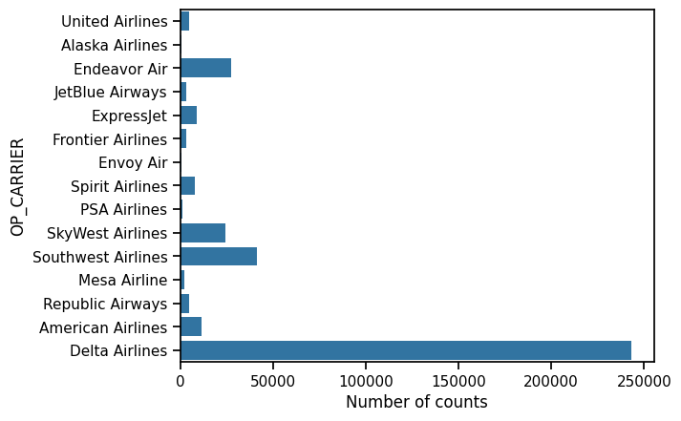
Exploratory data analysis
The bar chart displays the number of occurrences for different airlines, represented by the OP_CARRIER label on the y-axis, providing a measure of how often each airline appears in the dataset

Slide 6
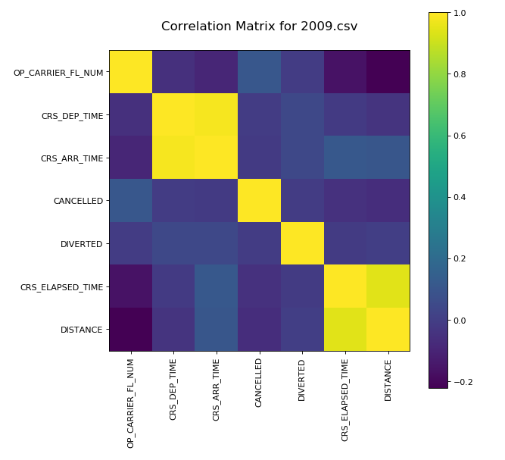
Correlation matrix of the dataset

Slide 7
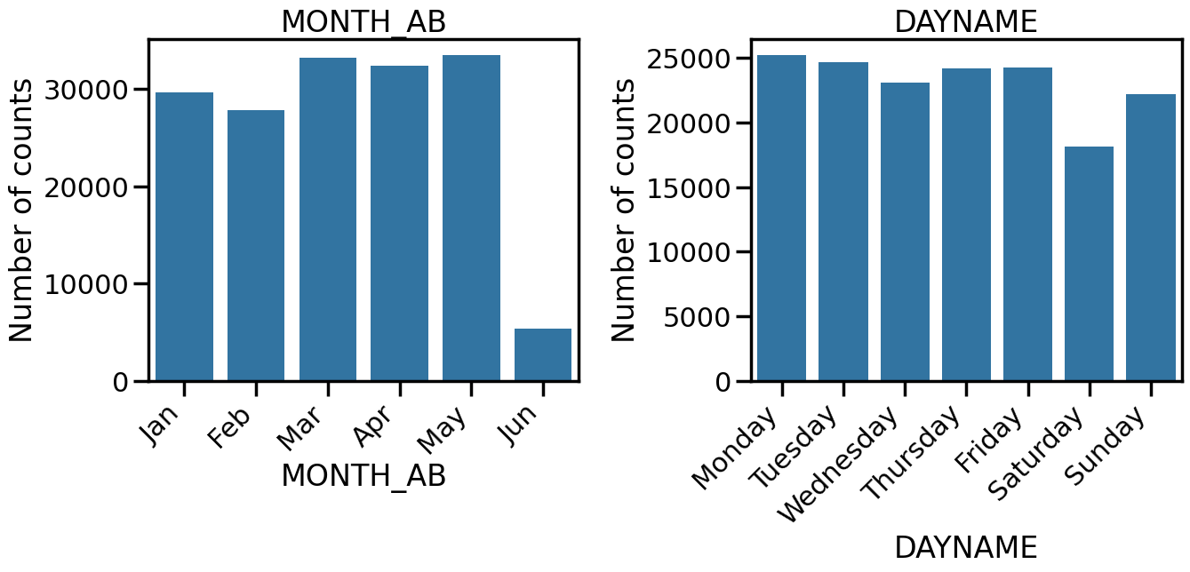
Delays according to the day of week

Slide 8
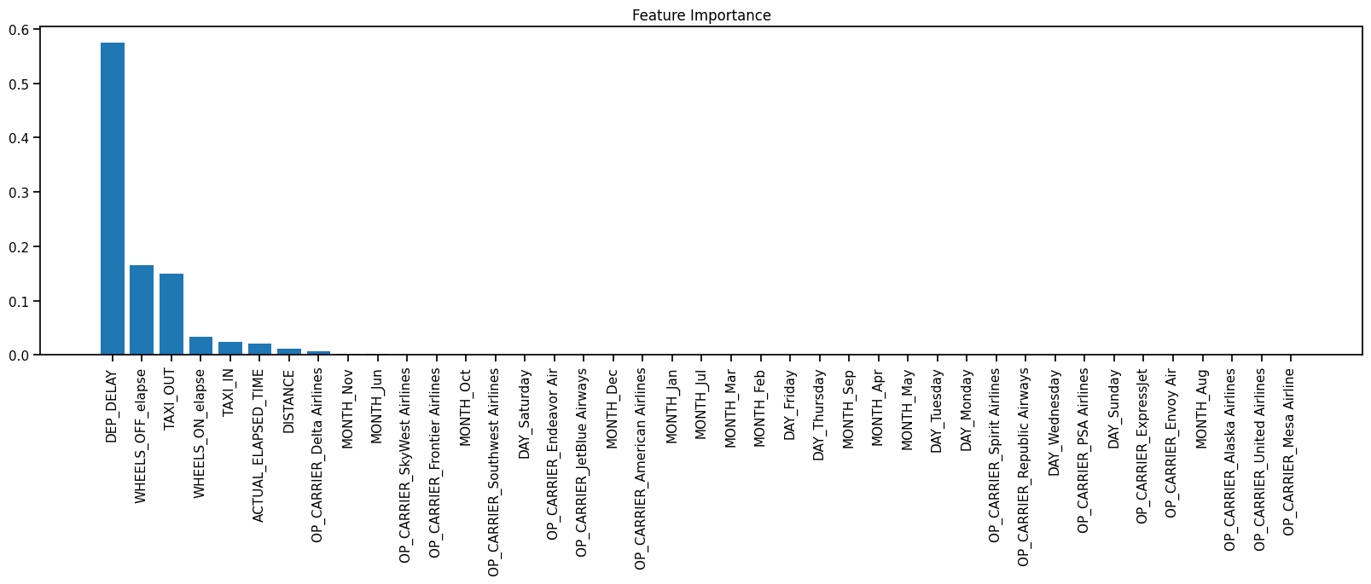
Features importance

Slide 9
IMPLEMENTATION
I have implemented two models for predicting flight delays:
Random Forest Algorithm: Random Forest is an enhanced version of ensemble scheme of learning used for classification and regression problems. It forms several decision trees when learning and gives out the median of the classes (incase of classification) or the mean of the predictions (incase of regression) of the trees.
Decision Tree Classifier: A Decision Tree Classifier is a supervised learning model that can used in classification problems. It is a tree structure extracting branches at decision point depending on feature value each internal node represents a "test", each branch represents the outcome of the test, and each leaf node represents a class label.

Slide 10
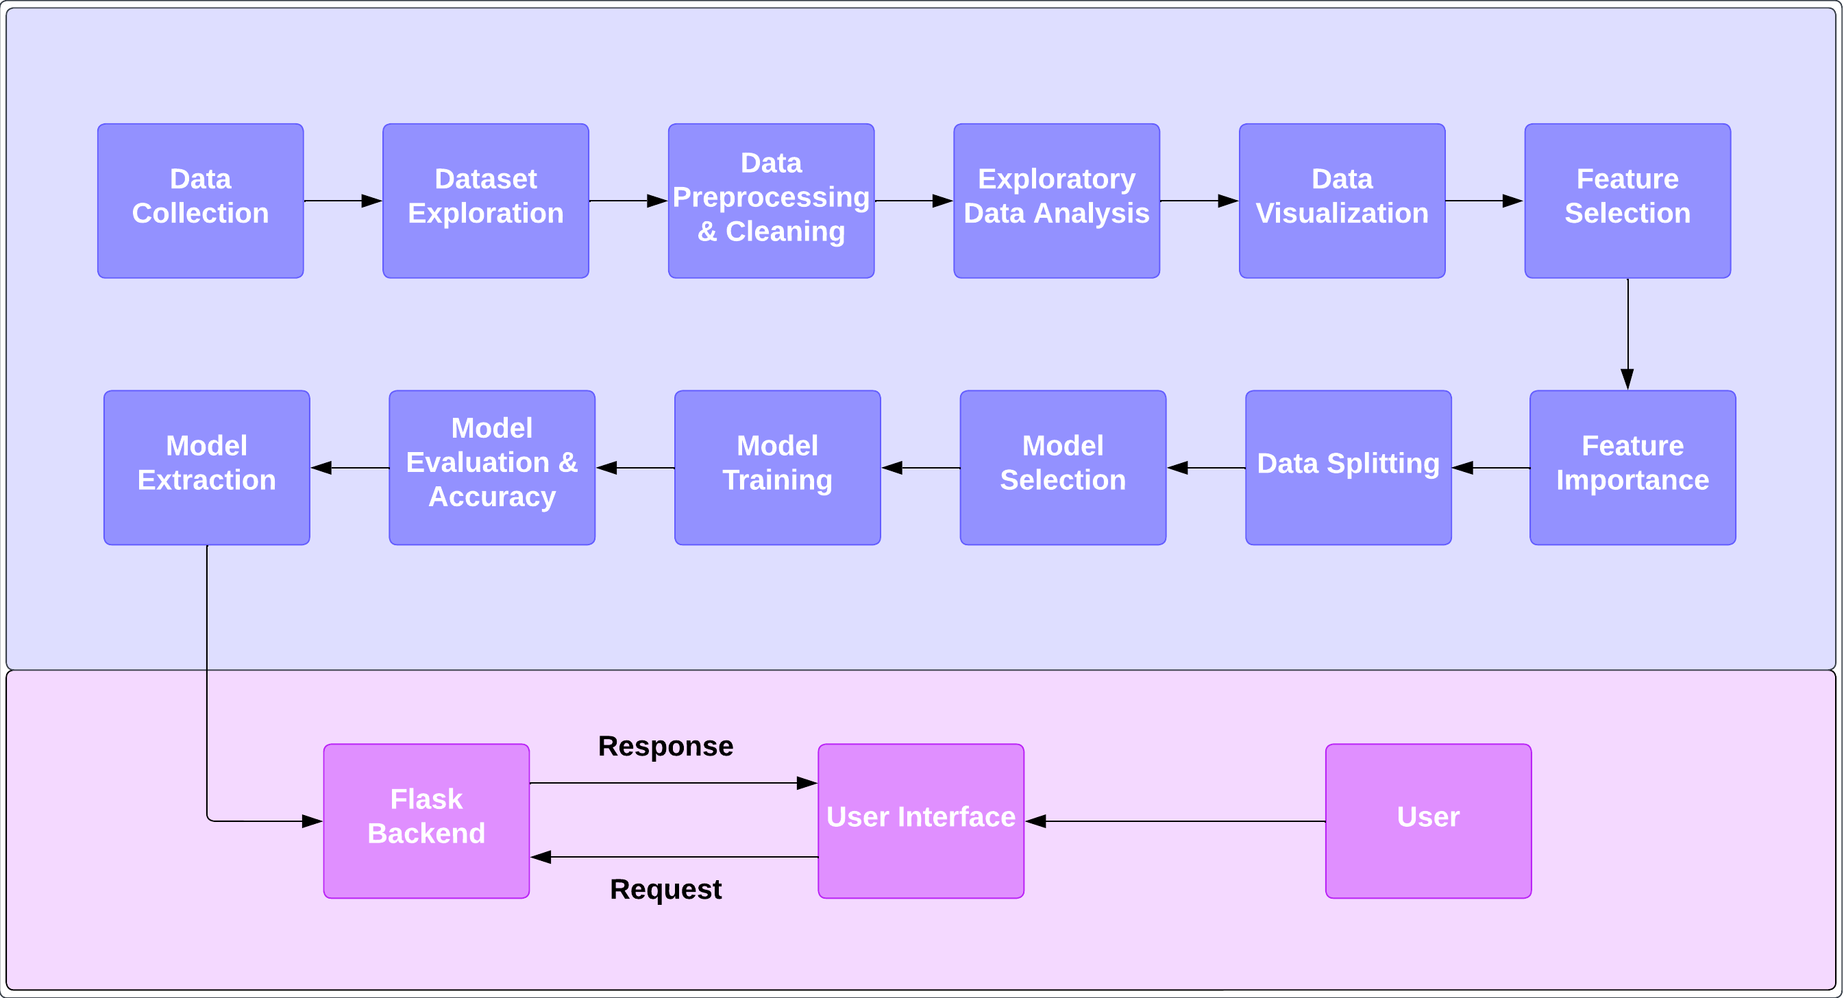
Methodology

Slide 11
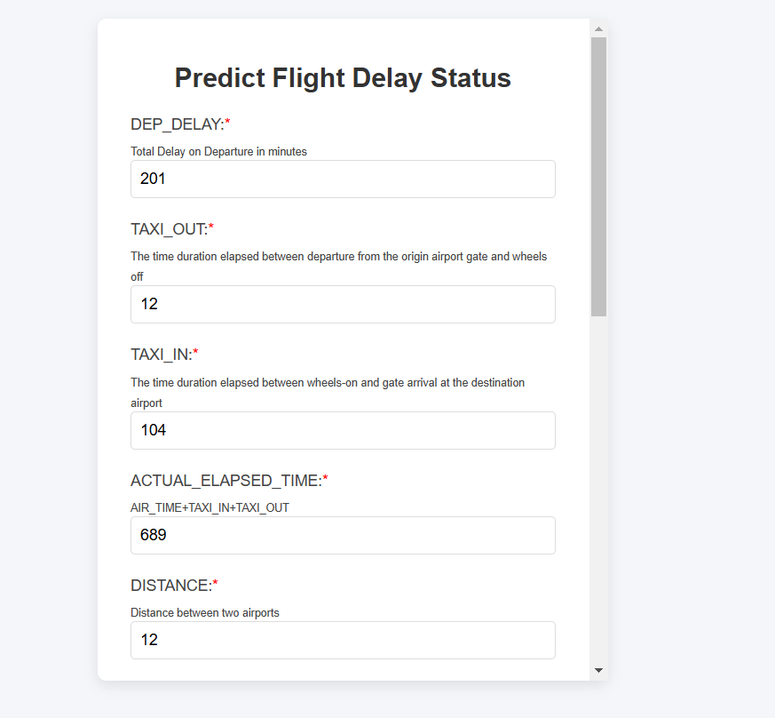
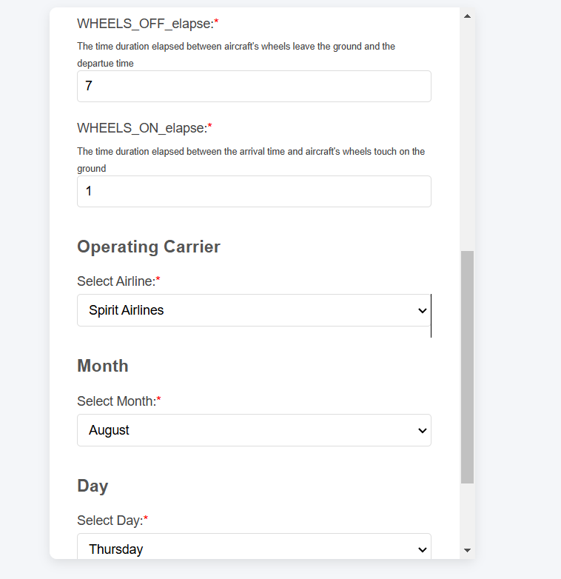
User Interface

Slide 12
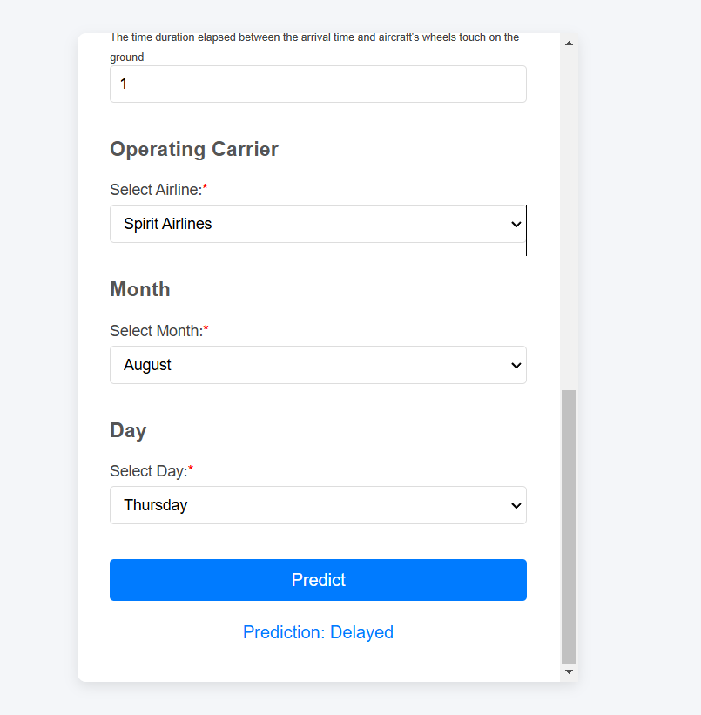
OUTPUT

Slide 13
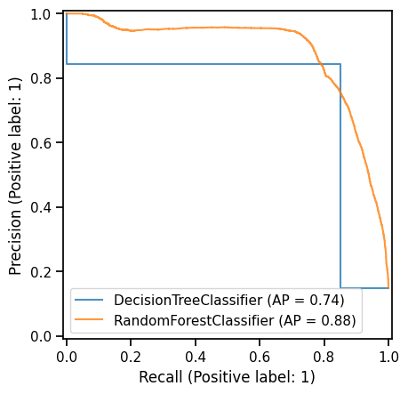
results
Precision recall curve comparing the performance of the two models. It helps in understanding the trade-off between precision and recall for different thresholds.
Precision(y-axis): Precision measures the proportion of true positive predictions (actual delays) out of all instances predicted as positive (predicted delays).
Recall (x-axis): The percentage of real positive cases (delays) that the model properly classified as positive is known as recall (or sensitivity). high recall means that the model minimizes missing delays (false negatives) by capturing majority of the real delays.

Slide 14
Conclusion
nclude variables such as crew schedules, maintenance logs, and gate assignments.
My analysis found that Random Forest performs better in predicting flight delays, achieving the highest accuracy and ROC AUC scores. The effectiveness of this algorithm is attributed to its ability to capture complex patterns in the data.
Future work could explore incorporating additional features, such as utilizing live air traffic data to account for congestion and rerouting scenarios. Include variables such as crew schedules, maintenance logs, and gate assignments.

Slide 15
REFERENCES
[1] Yuemin Tang. 2021. Airline Flight Delay Prediction Using Machine Learning Models. In 2021 5th International Conference on E-Business and Internet (ICEBI 2021), October 15-17, 2021, Singapore, Singapore. ACM, New York, NY, USA, 7 Pages. https://doi.org/10.1145/3497701.3497725.
[2] Irmak Hatipoglu and Omur Tosun “Predictive Modeling of Flight Delays at an Airport Using Machine Learning Methods” http://dx.doi.org/10.3390/app14135472
[3] Oladipupo, T. (2010). Types of machine learning algorithms. New Advances in Machine Learning. https://doi.org/10.5772/9385
[4] Azib Anees; Wei Huang, “Flight Delay Prediction: Data Analysis and Model Development”. In 2021 26th International Conference on Automation and Computing (ICAC). DOI: 10.23919/ICAC50006.2021.9594260
[5] D. Truong, “Using causal machine learning for predicting the risk of flight delays in air transportation”. Journal of Air Transport Management. 2021. Volume 91. pp101993
[6] M. Kim and J. Bae, “Modelling the flight departure delay using survival analysis in South Korea”. Journal of Air Transport Management, 2021, Volumn 91. pp101996
[7] J. Qu, T. Zhao, M. Ye, J. Li and C.Liu. “Flight Delay Prediction Using Deep Convolutional Neural Networks Based on Fusion of Meteorological Data”. Neural
Processing Letters, 2020, Vol. 52, pp.1461-1484.
[8] B. Yu, Z. Guo, S. Asian, H. Wang and G. Chen. “Flight delay prediction for commercial air transport: A deep learning approach”. Transportation Research Part E: Logistics and Transportation Review, 2019, Volume 125, pp. 203-221.

Slide 16
THANK YOU

